Slide 1
PROJECT TITLE
AD4V71 - Machine Learning Operations (MLOps)
Fake Website Detection System Using Artificial Intelligence
Presenting By
Team Member 1 Name :Jason Thomas
Team Member 1 Regd No. : 24AD0110
Team Member 1 Section : C
Team Member 2 Name :Bobby Anderson
Team Member 2 Regd No. : 24AD0104
Team Member 2 Section : C

Slide 2
Problem Identification and Title Justification
Relevance of the Problem
Fake websites steal personal and financial data.
Users often cannot identify phishing sites.
AI enables faster and more accurate detection.
Clarity of Problem Statement
Build an AI system to classify websites as Legitimate or Fake using URL and webpage features.
Justification of Project Title & Scope
The title reflects the use of AI for phishing website detection.
Scope includes website analysis, AI-based classification, and user alerts to improve online safety.

Slide 3
Problem Identification and Title Justification
Artificial Intelligence (AI): Uses machine learning to identify patterns in website data.
Phishing Websites: Fake websites designed to steal sensitive user information.
Feature Extraction: Analyzes URL length, HTTPS status, domain age, and suspicious keywords.
Machine Learning Classification: Predicts whether a website is Legitimate or Fake.
Cybersecurity: Protects users from online threats and phishing attacks.

Slide 4
Literature Survey
Existing System | Advantages | Disadvantages
Blacklist-Based Detection | Fast and easy to implement | Cannot detect new phishing sites
Rule-Based Systems | Simple logic and low cost | Poor adaptability to new attacks
URL Feature Analysis | Good detection using URL patterns | May miss advanced phishing sites
Machine Learning Models | Learns from data and improves accuracy | Requires quality training data
Deep Learning Approaches | High detection performance | Computationally expensive
Research Gap
Existing methods struggle with newly created phishing websites.
Many systems rely only on blacklists or fixed rules.
AI-based detection can identify previously unseen threats with better accuracy.

Slide 5
Objectives of the Project
Develop an AI model to detect fake and phishing websites.
Analyze URL and website features for classification.
Improve detection accuracy using machine learning.
Alert users before they access suspicious websites.
Enhance online security and protect user data.

Slide 6
Project Planning and Time Schedule
Task | Week 1 | Week 2 | Week 3 | Week 4
Requirement Analysis | ✓
Dataset Collection | ✓ | ✓
Data Preprocessing |  | ✓
Feature Extraction |  | ✓
AI Model Development & Training |  |  | ✓
Testing & Evaluation |  |  | ✓ | ✓
Documentation & PPT Preparation |  |  |  | ✓

Slide 7
Project Planning and Time Schedule
Task Allocation
Dataset Collection
AI Model Development
Testing & Validation
Documentation & PPT Preparation
Milestones
Complete data preparation
Train and evaluate the AI model
Deploy prototype and finalize presentation

Slide 8
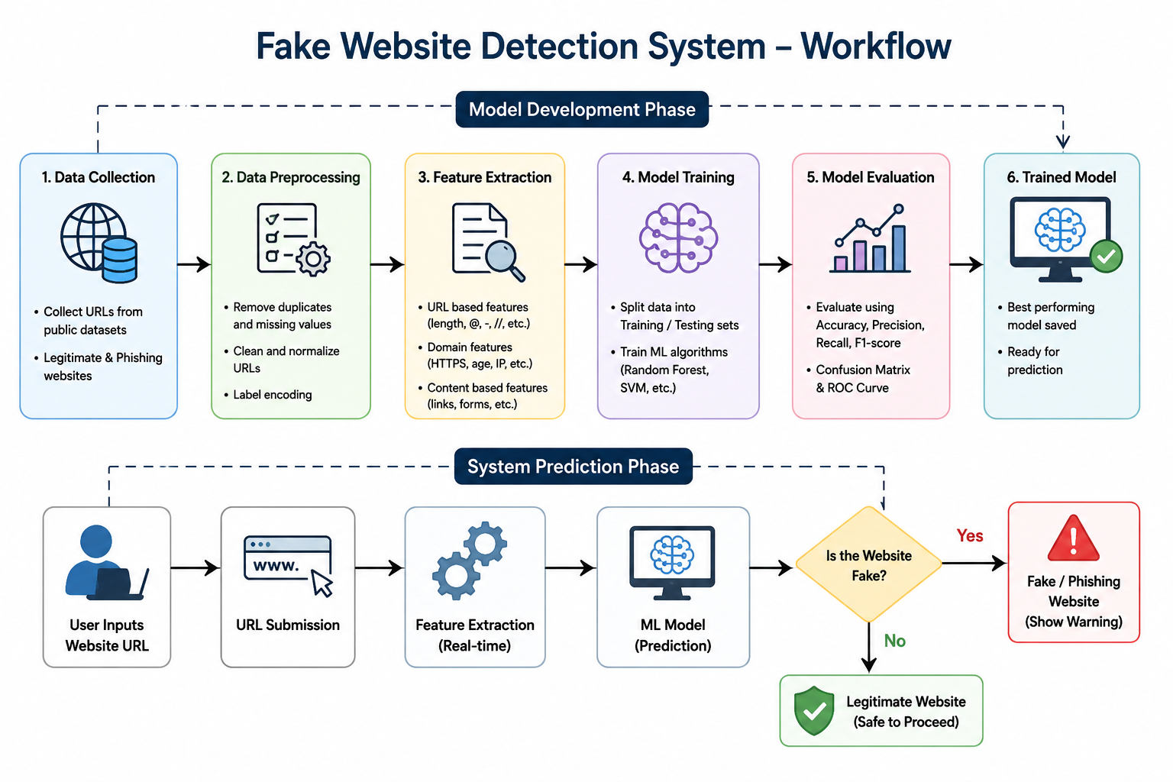

Slide 9
References
Kaggle – Phishing Website Dataset (https://www.kaggle.com/)
UCI Machine Learning Repository – Phishing Websites Data Set (https://archive.ics.uci.edu/)
Scikit-learn Documentation – https://scikit-learn.org/
IEEE Xplore Digital Library – https://ieeexplore.ieee.org/
Google Safe Browsing – https://safebrowsing.google.com/

Slide 10
Thank You!

